Slide 1


IBM Project
Title:
Network Bottlenecks in Virtualized Platforms
Group 5:
Aryaan Ghosal 500105236
Anugya Agarwal 500102028
Rishika Raj 500101763
Gaurav Kumar 500105743
Aryan Sharma 50016036
Guided by:
Mr. Himadri Sekhar Roy

Slide 2

Content
Introduction
Problem Statement
Motivation
Objectives
Tech Stack
Methodology
SWOT Analysis
PERT Chart
Result

Slide 3
1. Introduction
Cloud computing and virtualization allow multiple VMs to share the same physical infrastructure.
While this increases efficiency and scalability, it also introduces network performance challenges.
Network bottlenecks occur when demand for NICs, switches, or bandwidth exceeds available capacity.
Effects include:
High latency
Packet loss
Slow application performance
This project focuses on simulating, monitoring, and optimizing network bottlenecks in a virtualized environment.

Slide 4

2. Problem Statement
In virtualized platforms, multiple VMs share the same physical network resources such as NICs, switches, and bandwidth. When demand exceeds capacity, network bottlenecks occur, leading to latency, packet loss, and degraded application performance. Detecting and optimizing these bottlenecks remains a major challenge in ensuring reliable cloud performance.

Slide 5




3. Motivation
Reliable Cloud Performance
Resource Utilization
Scalable & Efficient Networking

Slide 6
4. Objectives
The objective of this project is to simulate and analyze network bottlenecks in virtualized cloud environments and propose strategies to optimize performance.
Simulate Network Bottlenecks using multiple EC2 instances in AWS.
Identify Performance Issues such as latency, packet loss, and NIC saturation.
Monitor Network Traffic using Prometheus and visualize metrics with Grafana.
Apply Traffic Control Mechanisms (Linux tc) to manage congestion.
Demonstrate Optimization Techniques for efficient resource utilization.
Provide Insights for building scalable and reliable cloud networking systems.

Slide 7

5. Technology Stack
Cloud Platform
The project is deployed on Amazon Web Services (AWS), utilizing EC2 instances within a Virtual Private Cloud (VPC) for simulation and testing of network bottlenecks.
Traffic Simulation Tool
iperf3 is used to generate and measure network traffic between client and server instances to identify congestion and bottlenecks.
Monitoring & Metrics
Prometheus is used to collect metrics such as bandwidth usage, latency, and packet loss, while Grafana provides real-time visualization dashboards.
Traffic Control
The Linux tc (Traffic Control) tool is applied to shape and limit bandwidth, demonstrating optimization and congestion management.

Slide 8
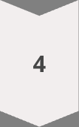
6. Methodology
Environment Setup
Created a VPC with public and private subnets.
Launched 3 EC2 instances: 1 server (private subnet) and 2 clients (public subnet).
Traffic Simulation
Used iperf3 to generate traffic between clients and server.
Simulated concurrent data transfer to analyze network congestion.
Monitoring & Detection
Integrated Prometheus to collect metrics like bandwidth usage, latency, and packet drops.
Visualized results in Grafana dashboards for real-time analysis.
Applying Traffic Control
Implemented Linux tc commands to apply bandwidth shaping.
Compared performance before and after optimization.

Slide 9
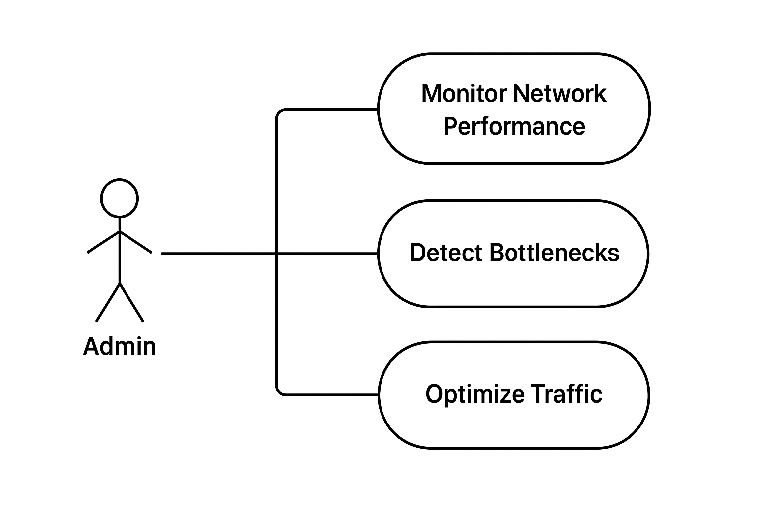
6. Methodology (contd.)
Fig: Use Case Diagram

Slide 10
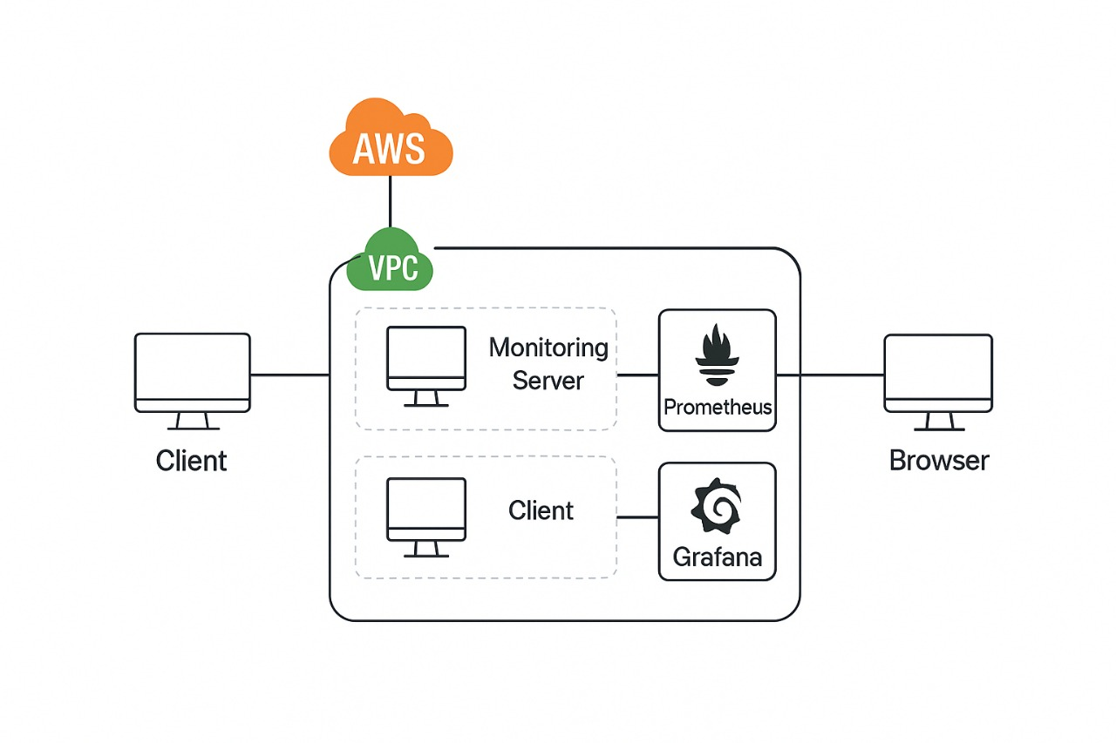
6. Methodology (contd.)
Fig: System Architecture

Slide 11
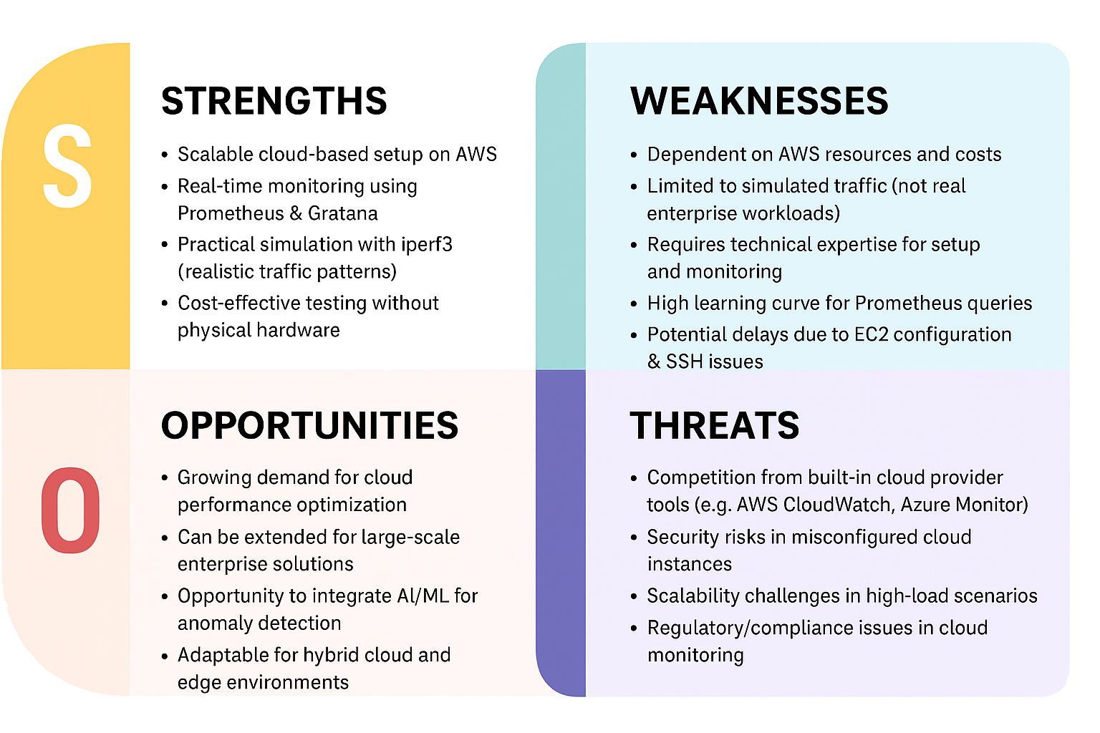
7. SWOT Analysis

Slide 12
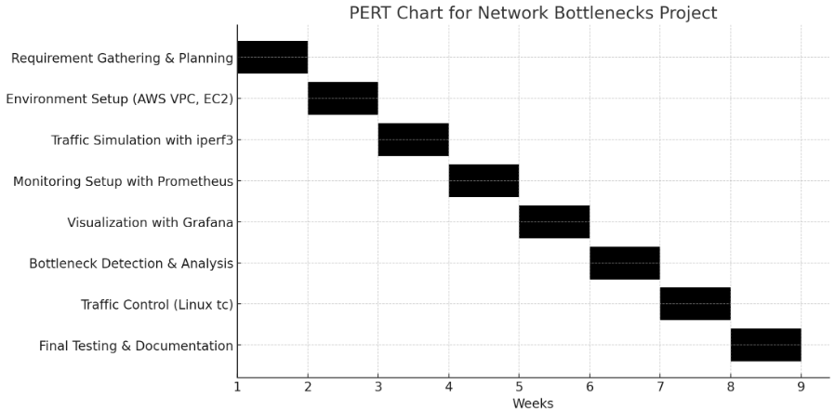
9. PERT Chart
Fig: Program Evaluation Review Technique Chart

Slide 13
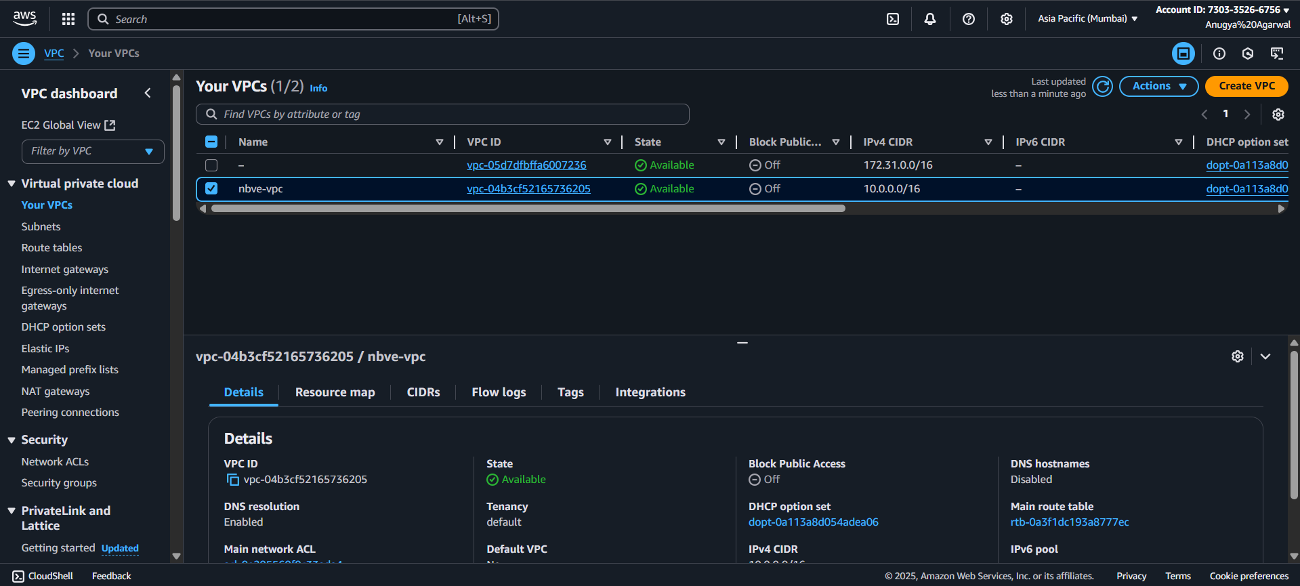
10. Result
Fig: VPC

Slide 14
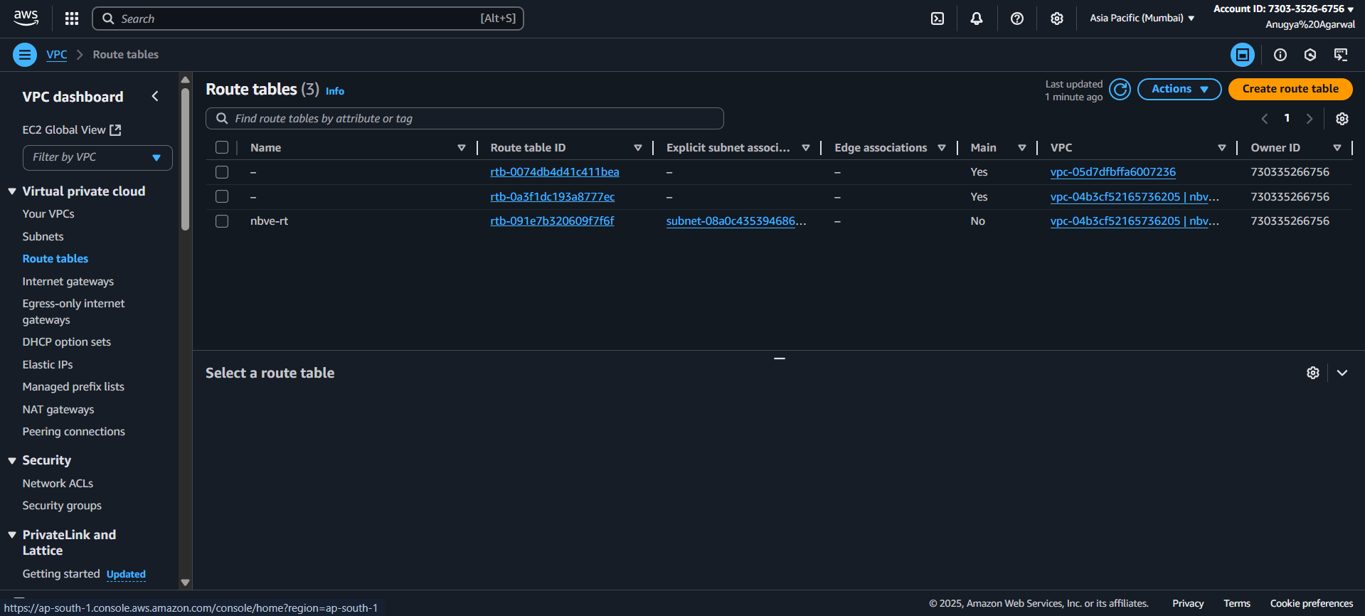
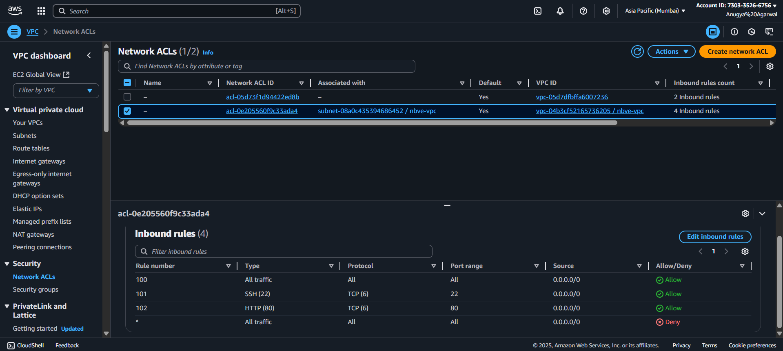
10. Result
Fig: Network Setup

Slide 15
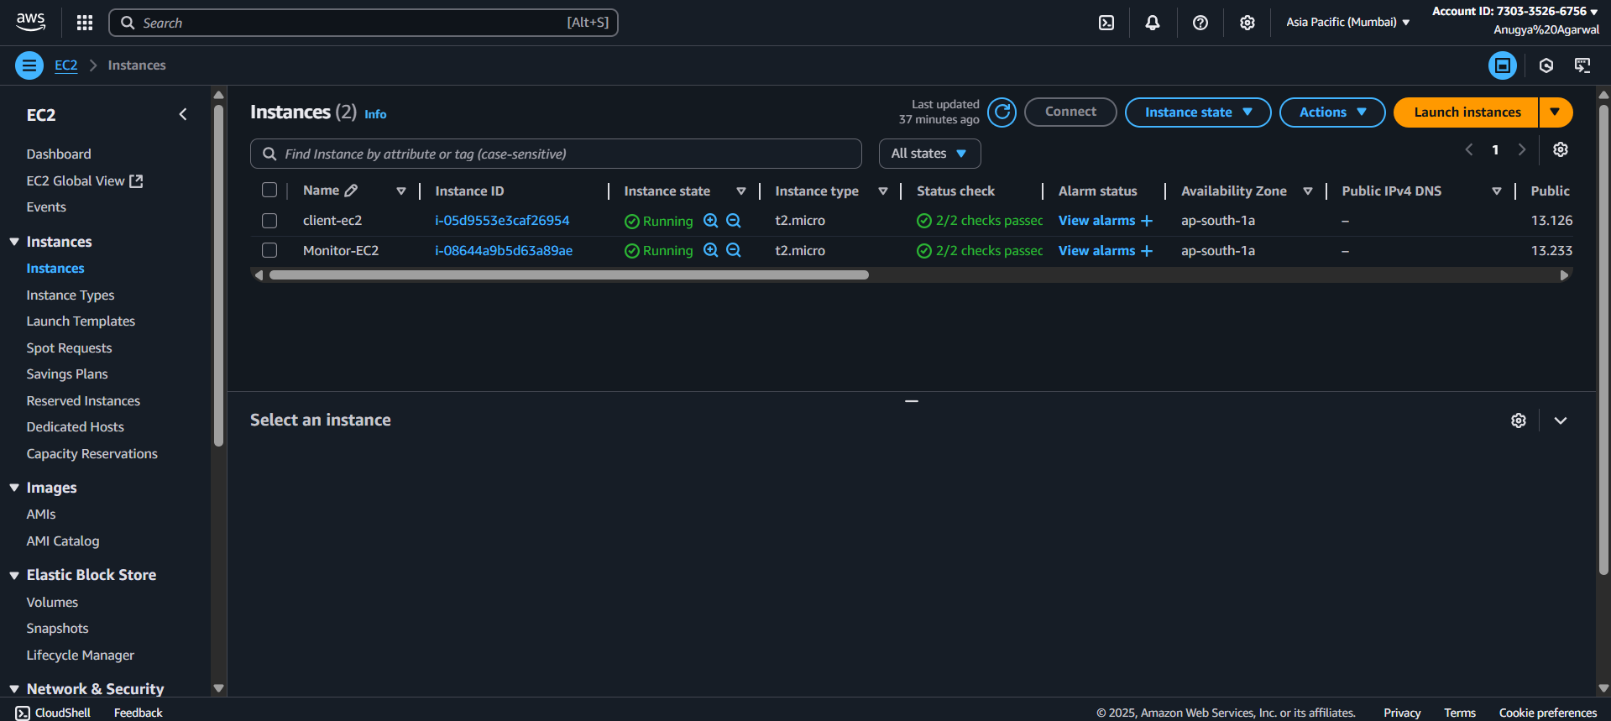
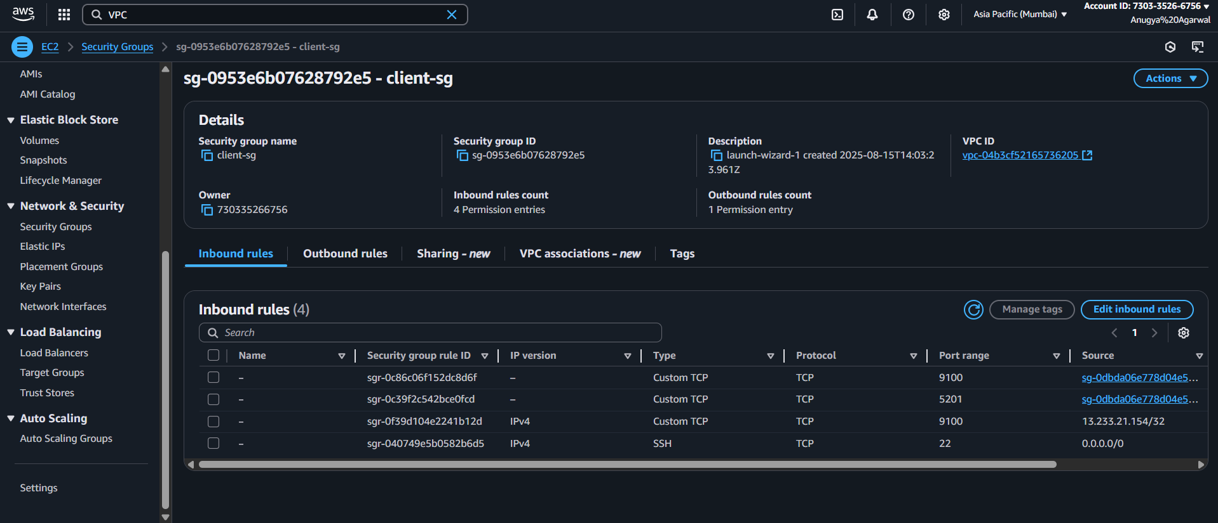
10. Result
Fig:E c2 Instances

Slide 16
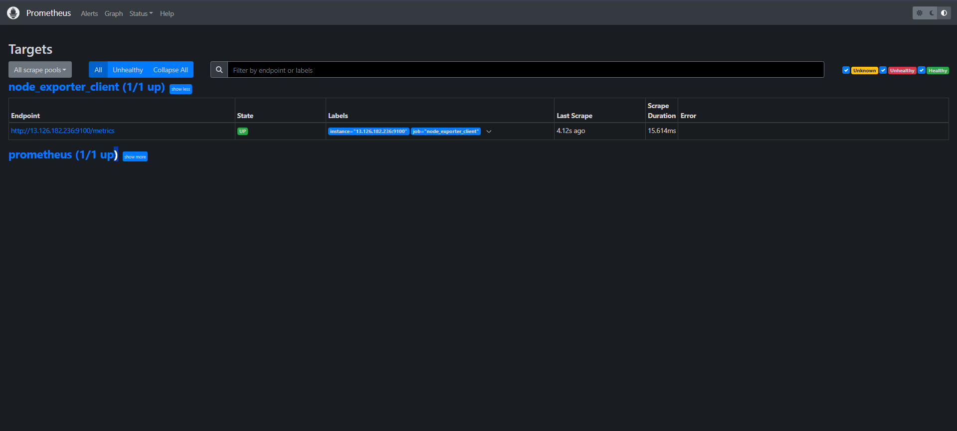
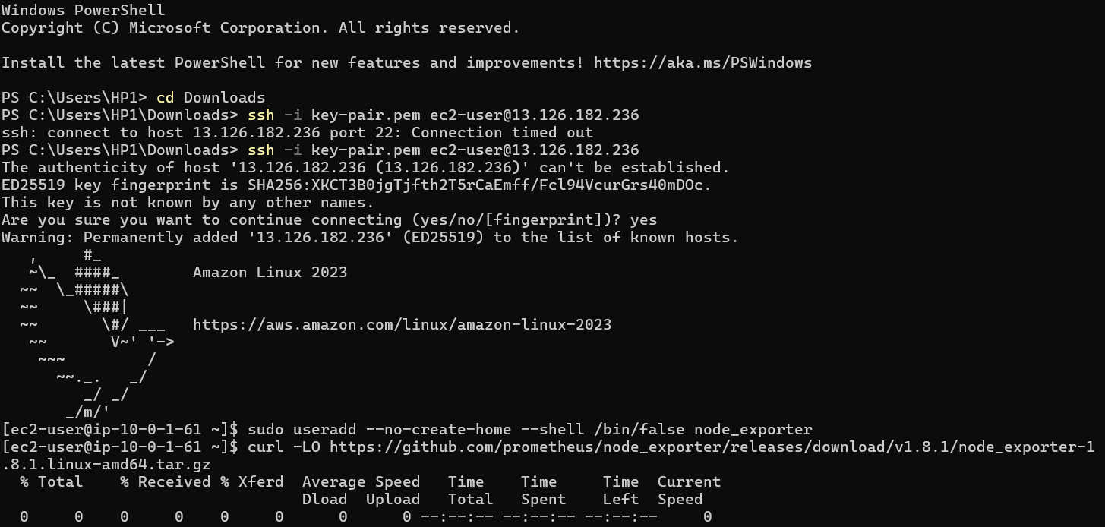
10. Result
Fig: Prometheus

Slide 17
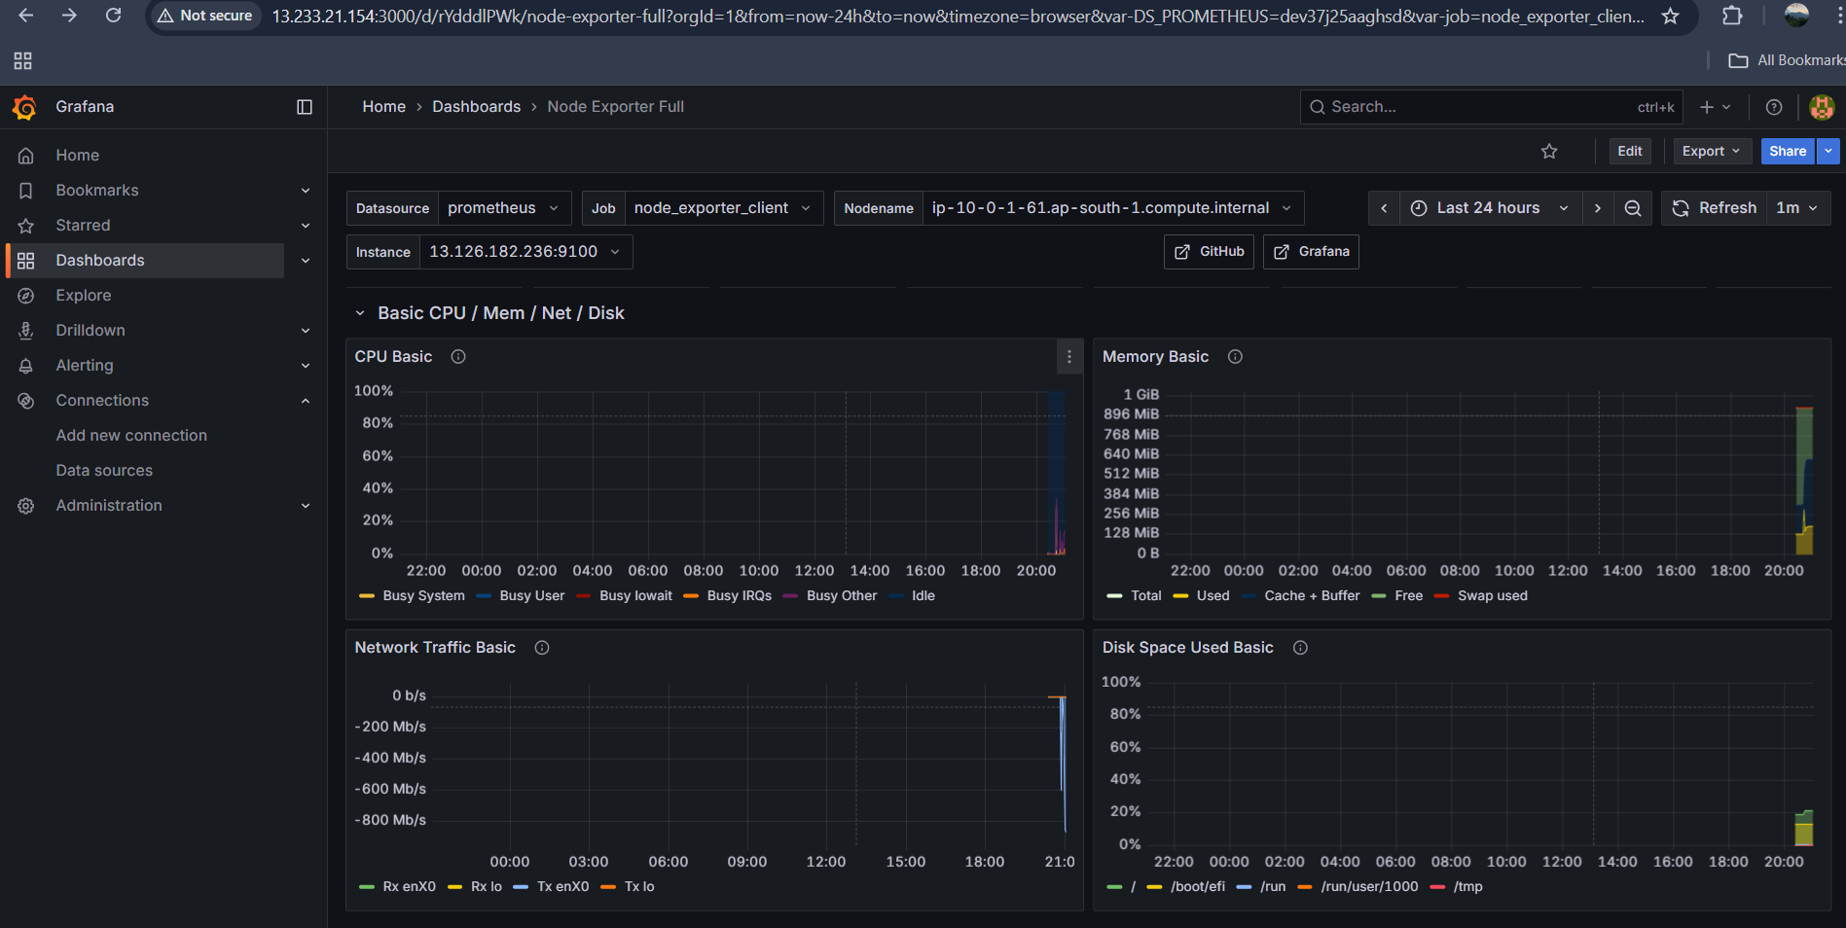
10. Result
Fig: Grafana Dashboard

Slide 18
Thank You

